Slide 1
Classification and Logistic Regression

Slide 2
classification
In Machine Learning and Statistics, Classification is the problem of identifying to which of a set of categories (subpopulations), a new observation belongs, on the basis of a training set of data containing observations and whose categories membership is known.
Types of Classification
Classification is of two types:
Binary Classification:
When we have to categorize given data into 2 distinct classes. Example – On the basis of given health conditions of a person, we have to determine whether the person has a certain disease or not.
Multiclass Classification:
The number of classes is more than 2. For Example – On the basis of data about different species of flowers, we have to determine which specie does our observation belongs to.

Slide 3
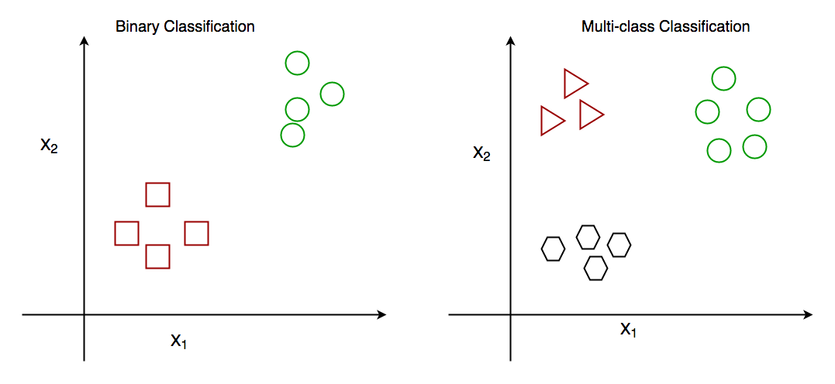

Slide 4
How does classification works?
Suppose we have to predict whether a given patient has a certain disease or not, on the basis of 3 variables, called features.
This means there are two possible outcomes:
The patient has the said disease. Basically, a result labeled “Yes” or “True”.
The patient is disease-free. A result labeled “No” or “False”.
This is a binary classification problem.
We have a set of observations called training data set, which comprises sample data with actual classification results. We train a model, called Classifier on this data set, and use that model to predict whether a certain patient will have the disease or not.

Slide 5
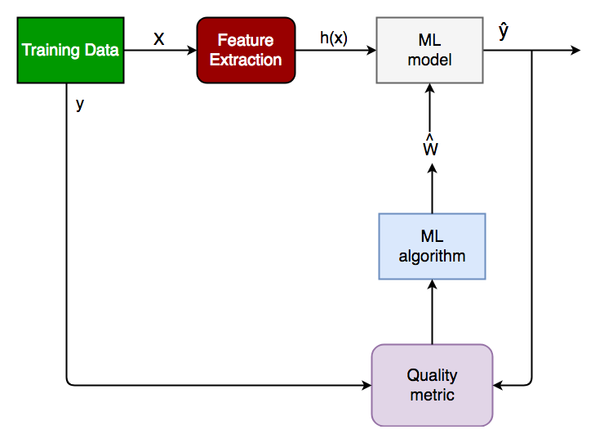
The outcome, thus now depends upon :
How well these features are able to “map” to the outcome.
The quality of our data set. By quality, I refer to statistical and Mathematical qualities.
How well our Classifier generalizes this relationship between the features and the outcome.
The values of the x1 and x2.

Slide 6
Generalized Classification Block Diagram.
X: pre-classified data, in the form of a N*M matrix. N is the no. of observations and M is the number of features
y: An N-d vector corresponding to predicted classes for each of the N observations.
Feature Extraction: Extracting valuable information from input X using a series of transforms.
ML Model: The “Classifier” we’ll train.
y’: Labels predicted by the Classifier.
Quality Metric: Metric used for measuring the performance of the model.
ML Algorithm: The algorithm that is used to update weights w’, which update the model and “learns” iteratively.

Slide 7
LOGISTIC REGRESSION
Logistic regression is one of the most popular Machine Learning algorithms, which comes under the Supervised Learning technique. It is used for predicting the categorical dependent variable using a given set of independent variables.
Logistic regression predicts the output of a categorical dependent variable. Therefore the outcome must be a categorical or discrete value. It can be either Yes or No, 0 or 1, true or False, etc. but instead of giving the exact value as 0 and 1, it gives the probabilistic values which lie between 0 and 1.
Logistic Regression is much similar to the Linear Regression except that how they are used. Linear Regression is used for solving Regression problems, whereas Logistic regression is used for solving the classification problems.
In Logistic regression, instead of fitting a regression line, we fit an "S" shaped logistic function, which predicts two maximum values (0 or 1).

Slide 8
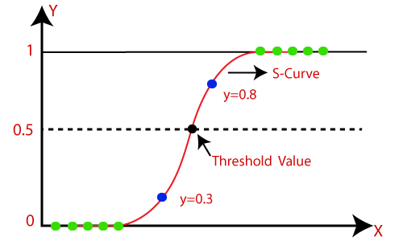
The curve from the logistic function indicates the likelihood of something such as whether the cells are cancerous or not, a mouse is obese or not based on its weight, etc.
Logistic Regression is a significant machine learning algorithm because it has the ability to provide probabilities and classify new data using continuous and discrete datasets.
Logistic Regression can be used to classify the observations using different types of data and can easily determine the most effective variables used for the classification. The below image is showing the logistic function:

Slide 9


Assumptions for Logistic Regression:
The dependent variable must be categorical in nature.
The independent variable should not have multi-collinearity.
Logistic Regression Equation:
The Logistic regression equation can be obtained from the Linear Regression equation. The mathematical steps to get Logistic Regression equations are given below:
We know the equation of the straight line can be written as:
In Logistic Regression y can be between 0 and 1 only, so for this let's divide the above equation by (1-y):
But we need range between -[infinity] to +[infinity], then take logarithm of the equation it will become:

Slide 10
Type of Logistic Regression:
On the basis of the categories, Logistic Regression can be classified into three types:
Binomial:
In binomial Logistic regression, there can be only two possible types of the dependent variables, such as 0 or 1, Pass or Fail, etc.
Multinomial:
In multinomial Logistic regression, there can be 3 or more possible unordered types of the dependent variable, such as "cat", "dogs", or "sheep“
Ordinal:
In ordinal Logistic regression, there can be 3 or more possible ordered types of dependent variables, such as "low", "Medium", or "High".

